Slide 1
BREAST CANCER CLASSIFICATION USING MACHINE LEARNING
2018/E/099 2018/E/108 2018/E/123

Slide 2
INTRODUCTION
Breast cancer is the second most common cancer globally, particularly among women.
Detecting it accurately is crucial for effective treatment.
In this research, the goal was to classify two major types of breast cancer: benign cancer and malign cancer.
Two machine learning methods, Naïve Bayes (NB) and K-Nearest Neighbors (KNN) were used for this binary classification and got the accuracies respectively 0.961932 and 0.975109.

Slide 3
DATASET
Wisconsin breast cancer datasets was used.
It consists of 699 clinical cases, with 11 attributes.
There we 16 missing data were identified. So, the dataset was limited to 683 samples.
Benign samples – 444 and Malign samples – 239

Slide 4
USED MACHINE LEARNING MODELS
In the research study,
K Nearest Neighbors (KNN)
Naïve byes (NB)
We chose,
Logistic Regression (LR)
Support Vector Classifier (SVC)
Decision Trees (DT)
Random Forest (RF)
Gradient Boosting (GB)

Slide 5
Results from the study
ML MODELS | ACCURACY | TOTAL PROCESS TIME (s)
NB | 0.961932 | 0.001182
KNN | 0.975109 | 0.002479

Slide 6
Methodology
Data collection and analysis
Data preprocessing
Model implementation
Hyperparameter tunning
Performance comparison

Slide 7
1. Data collection and analysis
First, the dataset was downloaded from the repository.
Checked the attributes and shape of the dataset. There were 699 samples, and 11 attributes included this dataset. The shape of the dataset was (699,11)
Checked duplicated records and null values. There were 8 duplicated samples and 16 null values. These null values were initially showed using ‘?’.

Slide 8
2. Data preprocessing
Removed ID column from the dataset.
Removed null values.
Replaces the classes (2->0 and 4 ->1)
Checked the datatype.

Slide 9
3. Model implementation
For the model implementation we have chose 5 additional machine learning models with NB and KNN.
Used machine learning models:
Logistic Regression (LR)
Support Vector Classifier (SVC)
Decision Trees (DT)
Random Forest (RF)
Gradient Boosting (GB)

Slide 10
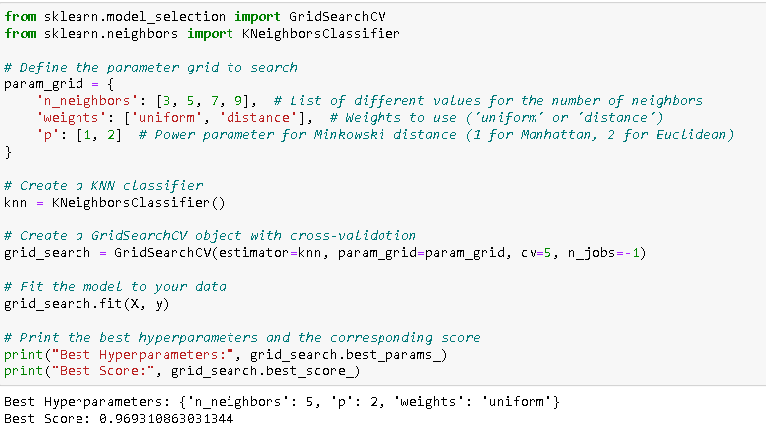
4. Hyperparameter tunning

Slide 11
RESULTS FOR DIFFERENT MACHINE LEARNING MODELS
NAÏVE BAYES
 | Value
Accuracy | 0.959049
Precision | 0.919158
Recall | 0.970656
F1-score | 0.943665

Slide 12
RESULTS FOR DIFFERENT MACHINE LEARNING MODELS
2. K – NEAREST NEIGHBOURS
 | Value
Accuracy | 0.959049
Precision | 0.966402
Recall | 0.955835
F1-score | 0.951497

Slide 13
RESULTS FOR DIFFERENT MACHINE LEARNING MODELS
3. LOGISTIC REGRESSION
 | Value
Accuracy | 0.96637
Precision | 0.959318
Recall | 0.945656
F1-score | 0.951735

Slide 14
RESULTS FOR DIFFERENT MACHINE LEARNING MODELS
4. SUPPORT VECTOR CLASSIFIER
 | Value
Accuracy | 0.96784
Precision | 0.944107
Recall | 0.966578
F1-score | 0.954864

Slide 15
RESULTS FOR DIFFERENT MACHINE LEARNING MODELS
5. DECISION TREES
 | Value
Accuracy | 0.951717
Precision | 0.927205
Recall | 0.937323
F1-score | 0.931733

Slide 16
RESULTS FOR DIFFERENT MACHINE LEARNING MODELS
6. RANDOM FOREST
 | Value
Accuracy | 0.96638
Precision | 0.952336
Recall | 0.945656
F1-score | 0.949216

Slide 17
RESULTS FOR DIFFERENT MACHINE LEARNING MODELS
7. GRADIENT BOOTING
 | Value
Accuracy | 0.96199
Precision | 0.955559
Recall | 0.937323
F1-score | 0.947414

Slide 18
PERFORMANCE COMPARISON
ML MODELS | ACCURACY | PRECISION | RECALL | F1-SCORE
NB | 0.959049±0.017577 | 0.919158 | 0.970656 | 0.943665
KNN | 0.966402±0.025515 | 0.955835 | 0.949911 | 0.951497
LR | 0.96637±0.0204 | 0.959318 | 0.945656 | 0.951735
SVC | 0.96784±0.018769 | 0.944107 | 0.966578 | 0.954864
RF | 0.96638±0.020914 | 0.952336 | 0.945656 | 0.949216
DT | 0.951717±0.016988 | 0.927205 | 0.937323 | 0.931733
GB | 0.96199±0.024561 | 0.955559 | 0.937323 | 0.947414

Slide 19
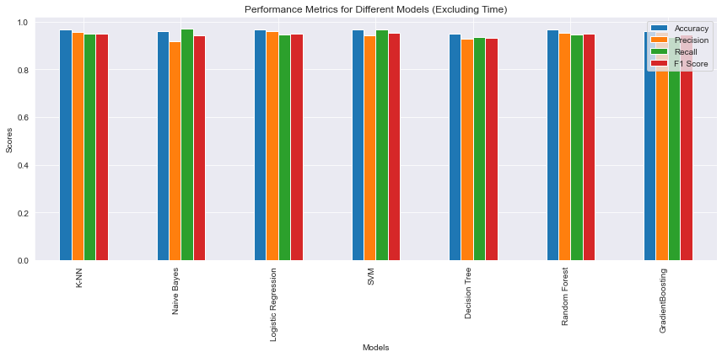
PERFORMANCE COMPARISON

Slide 20
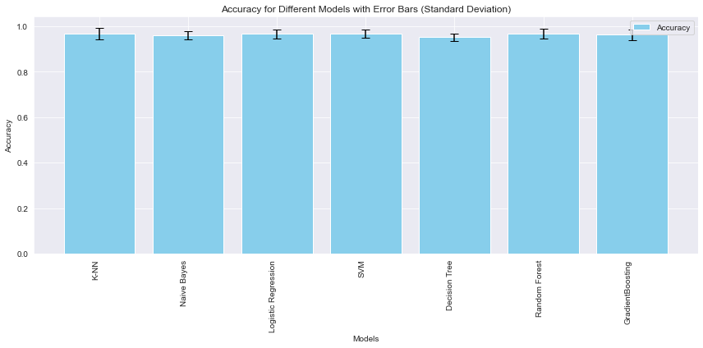
PERFORMANCE COMPARISON - ACCURACY

Slide 21
EXECUTION TIME FOR THE PROCESS
ML MODELS | TIME (s)
NB | 0.171842
KNN | 0.345099
LR | 0.203113
SVC | 0.347583
RF | 4.420627
DT | 0.153057
GB | 1.343661

Slide 22
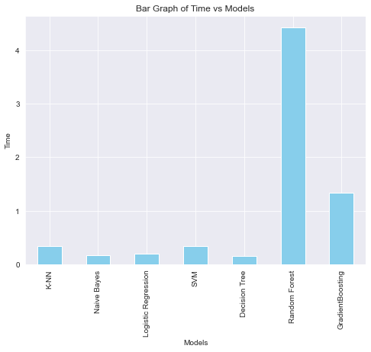
ESTIMATED TIME FOR THE PROCESS

Slide 23
CONCLUSION
Best machine learning model SVC which has highest accuracy 0.96784
Lowest accuracy was given by Decision Tree.
For these kind of cancer related classifications, it is better to calculate accuracy, precision, recall and F1-score rather than calculating accuracy.

Slide 24
THANK YOU !

